Slide 1

Task 2: Predicting customer buying behaviour
Presentation By : Parneet Kaur

Slide 2
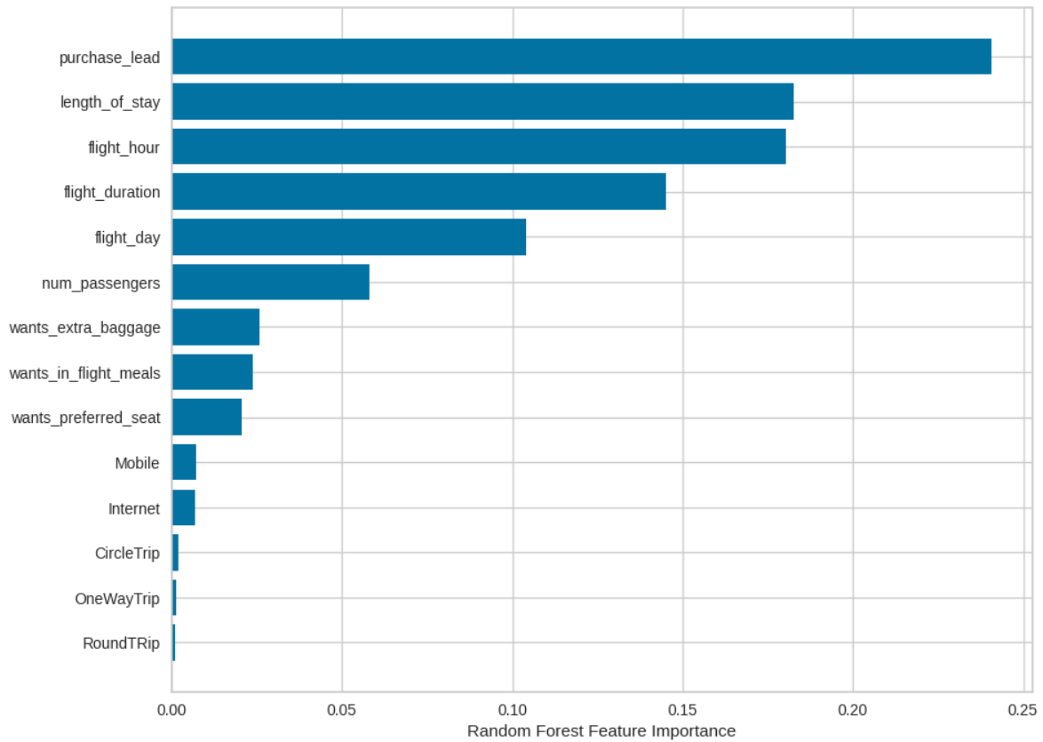
Top features which influence Customer buying behavior :
trained the data set with Random forest classifier model and received :
RECALL
PRECISION
F1-SCORE
ACCURACY
60%
63%
66%
63%
We are concerned with not predicting the successful bookings correctly. Imbalance dataset drives higher accuracy but it does not accurately predict the successful bookings.

